Slide 1


Presented By : Ashwini Sonawane
SEO Work Progress

Slide 2
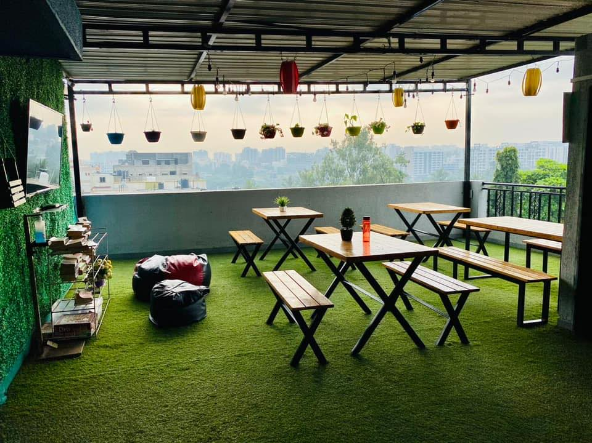
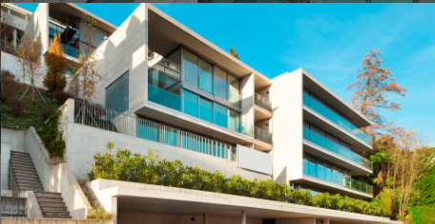
About Casa Stays
Casa Stays offers a premium selection of fully-furnished accommodations for professionals, students, and families seeking comfort and convenience in key locations. With a focus on hassle-free living, Casa Stays provides well-maintained properties, flexible rental terms, and exceptional customer service to ensure a seamless and enriching stay experience.
There are 5 Property
Casa Stays Ruby
Casa Stays Emerald
Casa Stays Blossom
Casa Stays Sapphire
Casa Stays Atlantis 27

Slide 3
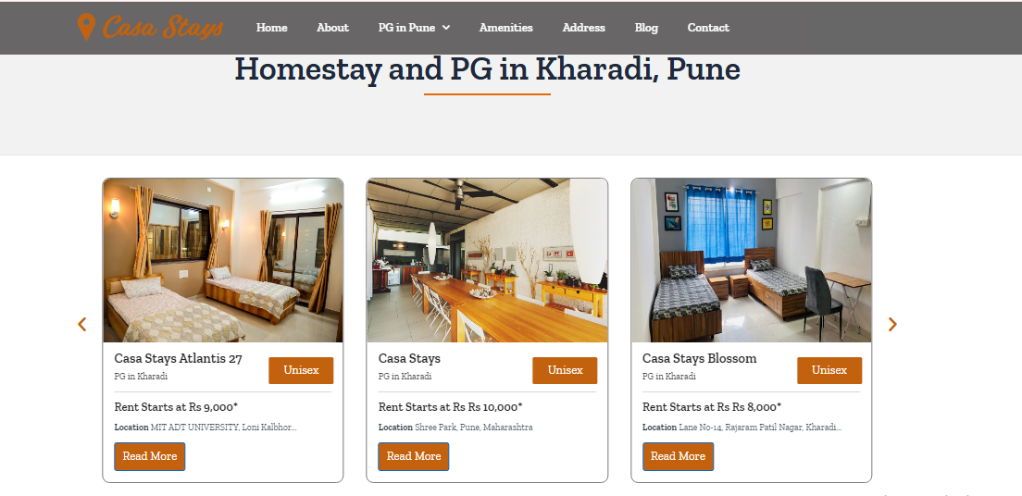
Increase in Organic Traffic Improve New Website Users Increase Keyword Ranking Position
Achieve Growth in Leads via Organic Channels and GMB.
What Was
Casa Stays Looking For?

Slide 4
Initial Analysis
Initial Analysis
Website Audit Highlights:
Weaknesses: Missing on-page SEO, Low domain authority, and under-optimized keywords and service content, with insufficient content pages, poorly optimized content, Social Channel not added, Form not available, Services not mention Properly, URL Structure, Testimonials Missing, FAQ Missing, All 14 Keywords are Not in 100
On-Page Optimization
Actions Taken:
Optimized Meta Titles, Descriptions, and Headers Keyword Wise.
Header Structure Is set SEO Perspective.
URL Structure set Properly
Footer Design Changed
Property Pages optimized, Also added Keywords
Add New Property Pages
Enhanced content with keyword integration and calls-to-action.
Added the FAQ – People Also Ask, Also Check the Competitors FAQ
Testimonials Added – With Real Photos
Suggest the Client For YouTube Channel – Suggest in November 24 Month

Slide 5
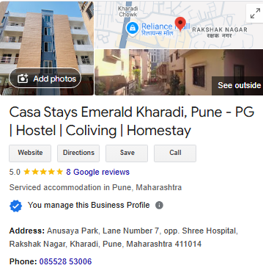
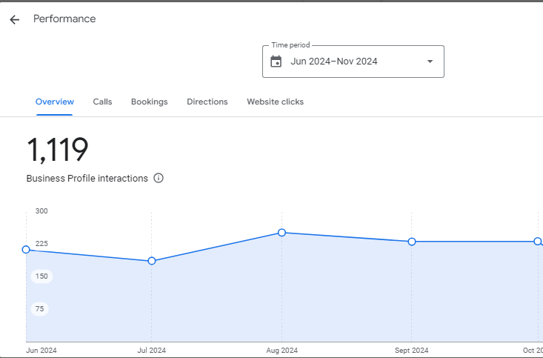
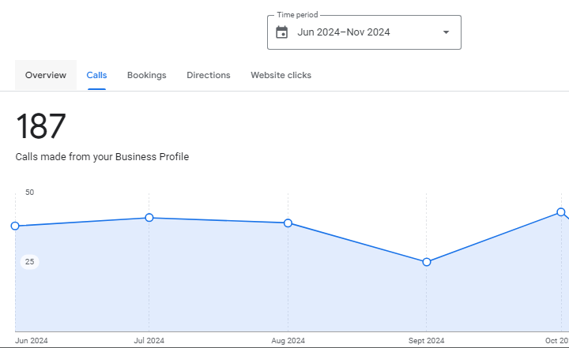
Initial Analysis
After Implementation : Result
After On-Page Implementation
Improved the Keyword Ranking – Currently 13 Keywords are in 1st Page
Increased organic traffic and impressions and clicks
Improved website loading speed.
GMB Calls Started to Improvement
Google My Business Profile Insights- June 2024 till Nov 2024 – Casa Stays Emerald Property

Slide 6
Off page Optimization
Use High Quality Backlinks – Most of the Focus on Content Related Activity – Web 2.0, Article Submission, Blog Posting
Using the Good DA Submission Sites
GMB Posting Along with Keywords In Hash tag
Publish Google reviews – Optimized Keywords
Major Focus on Quora Q & A
Promoting the Website Blogs in Content related Activity – Write some pitch added the internal linking.
https://casastaysblossom.blogspot.com/2024/12/benefits-of-choosing-pg-in-kharadi-pune.html
Use the High impression and clicks blogs For promotions, Also Suggest the Keywords as shown in GSC.

Slide 7
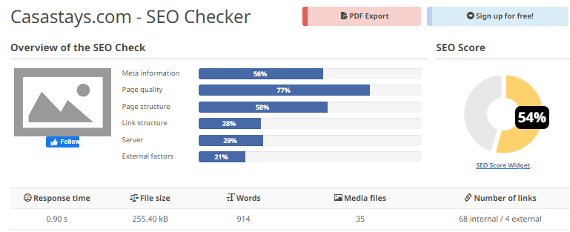
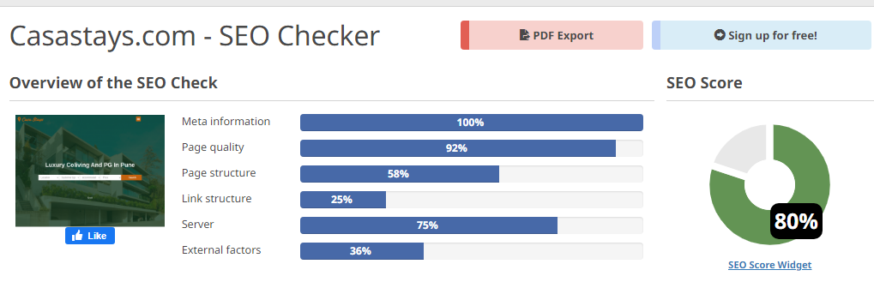
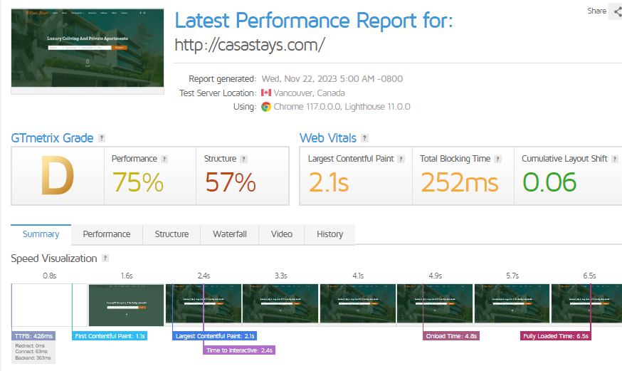
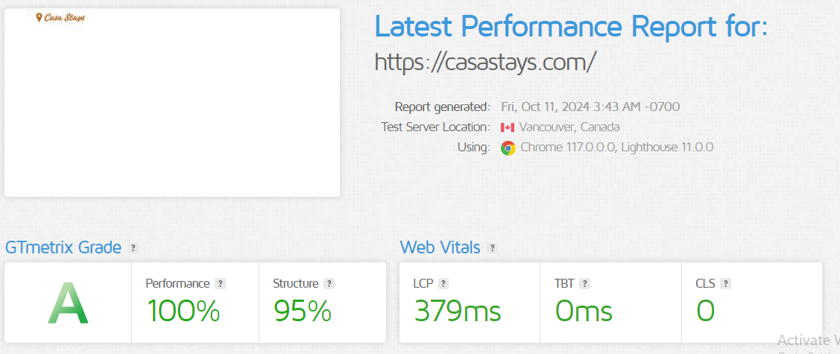
Website Speed
Before Implementing SEO Changes
After Implementing SEO Changes

Slide 8
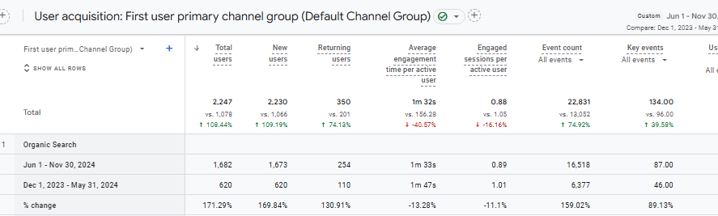
Organic Traffic Overview
We Can See the improvement in Organic Traffic - Increased by 171.29% is As compared to Last 6 months

Slide 9
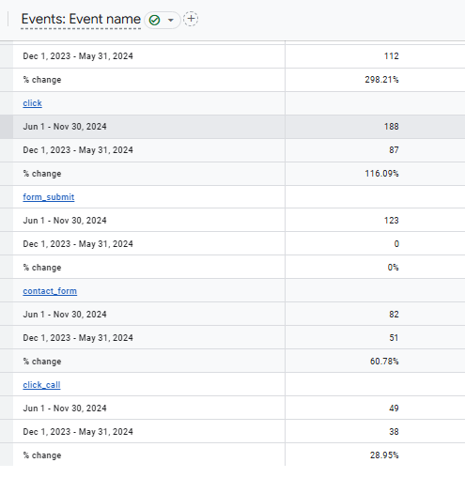
Events Overview – Last 6 Month
I have Compared the Period 6 Month,
We can see the Total Improvement 74.92%

Slide 10
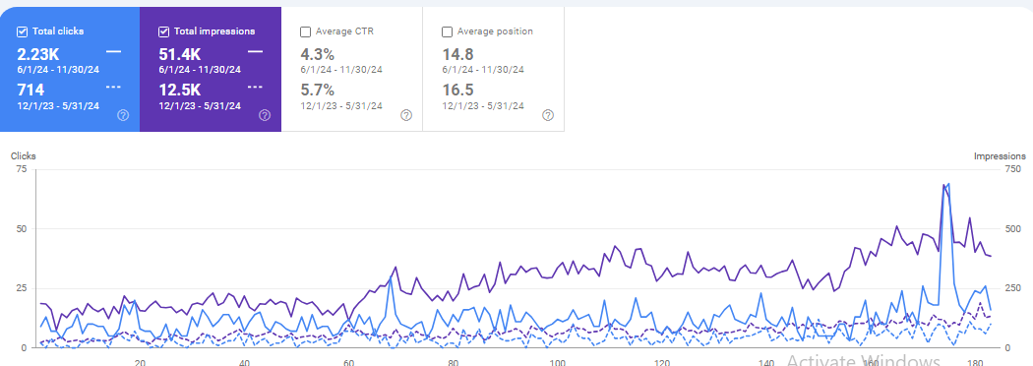
Google Search Console Overview
Month on Month Clicks and Impressions are increased from last 6 months.

Slide 11
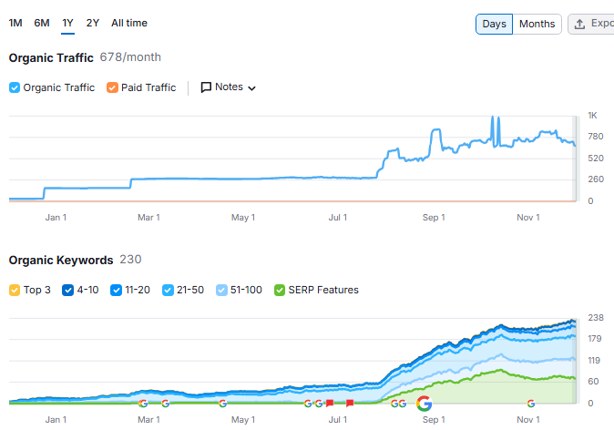
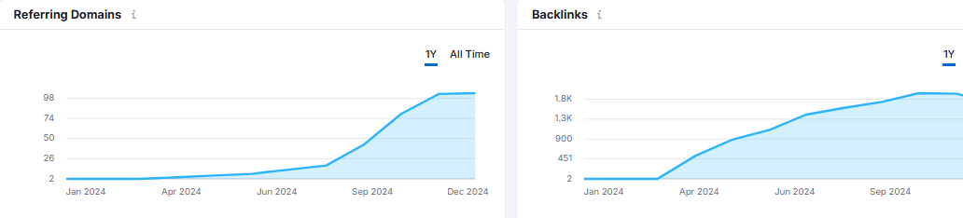
Semrush Overview
Organic traffic, Organic Keywords Are Improved.
Referring Domains and Backlink Count Improved Monthly

Slide 12
Keyword Ranking Performance
Working on 14 Keywords
28 Dec 23 Keywords Ranking Status – Not In 100 All Keywords
30 Nov 24 Keywords Ranking Status – 13 Keywords are Ranked
13 Keywords are Ranking on the 1st Page
13 5
Ranked 1st Page Ranked on Top 5
on Google Search Position SERP

Slide 13


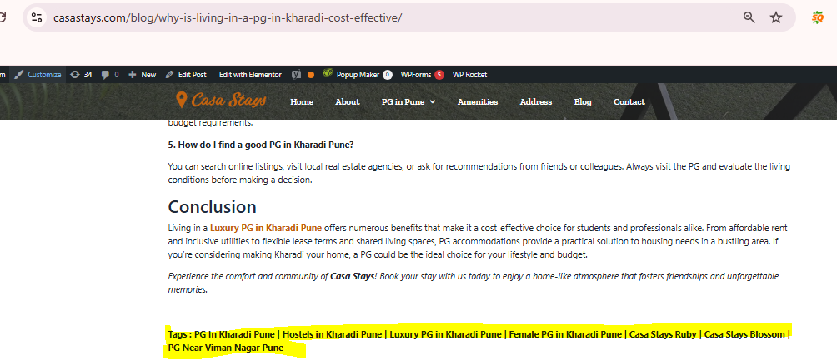
Blogs And GMB Strategy – Offer
Monthly I have Published 2 Blogs, Add FAQ For 1
Blog – People Also Ask, After add the FAQ Schema on
Particular Blog Page.
Discuss with Client and add the Offers in GMB and Blogs
along with Banner.
Added the Manually Tags in Blogs Pages
Blogs URL –
https://casastays.com/blog/5-reasons-to-select-kharadi-for-stay/
https://casastays.com/blog/living-like-a-local-embracing-culture-through-casa-stays/

Slide 14
THANK
YOU

